Slide 1

NEURAL NEWSROOM:
AI-POWERED NEWS SUMMARIZATION
By La Shawn Sykes and Frank Hanan
Notes:
This slide introduces the topic of using artificial intelligence to automatically summarize news articles, enabling more efficient and comprehensive news consumption.

Slide 2



EXECUTIVE SUMMARY
AI-Driven News Production
Personalized News Feeds
Multilingual Translation
AI algorithms can automatically generate news articles, headlines, and even entire stories, reducing the workload on human journalists.
AI-powered recommendation systems can curate news content tailored to individual user preferences, improving user engagement.
AI-powered translation tools can instantly convert news articles into multiple languages, enabling global distribution and accessibility.
The integration of AI technology into the news industry is revolutionizing how news is produced, distributed, and consumed, leading to increased efficiency, personalization, and reliability.
Notes:
Slide 2: Neural Newsroom revolutionizes news consumption through AI-powered summarization and classification. Our project harnesses the vast content from The Guardian API, employing a sophisticated CNN-LSTM hybrid model to categorize and distill news articles efficiently. We've developed a streamlined process that fetches, cleans, and analyzes news data, transforming it into concise, categorized summaries. Our user-friendly Gradio interface allows individuals to input topics of interest and receive tailored news reports, complete with downloadable PDF summaries. By automating the process of news curation and summary generation, Neural Newsroom addresses the growing challenge of information overload in the digital age. Our solution not only saves time for readers but also enhances comprehension by highlighting key points across various news categories. As we continue to refine our model and expand our data sources, Neural Newsroom stands at the forefront of AI's disruption of traditional news consumption, offering a glimpse into the future of personalized, efficient information delivery."

Slide 3

CONCEPT
The user story for the Neural Newsroom project is to provide a convenient and efficient way for readers to stay informed about the latest news. The project's motivation is to leverage the power of artificial intelligence to automatically summarize news articles, allowing users to quickly grasp the key points without having to read lengthy articles.
Notes:
Slide 3: The Power of AI in News Production [Introduction] Building on the previous overview of how AI is transforming the news industry, this slide delves deeper into the specific capabilities that AI brings to news production. The integration of AI technology has revolutionized the way news is created, from automatically generating content to enhancing personalization and global accessibility. [Key Points] 1. AI-Driven News Generation: AI algorithms can automatically generate news articles, headlines, and even entire stories, significantly reducing the workload on human journalists. This increased efficiency allows news organizations to produce more content in less time. 2. Personalized News Feeds: AI-powered recommendation systems can curate news content tailored to individual user preferences, improving user engagement and relevance. By understanding users' interests and behaviors, the neural newsroom system can deliver a personalized news experience. 3. Multilingual Translation: AI-powered translation tools can instantly convert news articles into multiple languages, enabling global distribution and accessibility. This breaking down of language barriers greatly expands the reach and impact of news coverage. [Transition] These AI-driven capabilities demonstrate the transformative potential of the neural newsroom project, paving the way for a more efficient, personalized, and globally accessible news experience. Let's now explore how we can leverage data collection and API integration to power these innovative features.

Slide 4
DATA COLLECTION
Accessing the Guardian API
The Guardian API provides a way to retrieve news articles and related data from the Guardian news organization. This API can be used to collect data for news summarization and analysis.
Retrieving Article Data
The Guardian API allows developers to search for and retrieve specific articles based on keywords, topics, or other criteria. This can be used to gather a dataset of news articles for processing and analysis.
Handling API Requests
Interacting with the Guardian API involves making HTTP requests to the appropriate API endpoints and handling the response data, which is typically returned in JSON format. This requires managing API authentication, rate limiting, and error handling.
Storing and Preprocessing Data
Once the article data is retrieved from the Guardian API, it needs to be stored and preprocessed for use in the neural newsroom system. This involve cleaning the text, extracting relevant metadata, and converting the data into a format suitable for machine learning tasks.
Notes:
Slide 4: Our data cleanup and exploration phase was crucial in preparing a high-quality dataset for our CNN-LSTM model. We standardized the text data from The Guardian API by removing special characters and converting to lowercase. We then tokenized the text, removed common stop words, and encoded article categories numerically. To ensure uniform input for our neural network, we implemented sequence padding. For model evaluation, we created a visual training history diagram using Matplotlib, which helped us track accuracy and loss over epochs. We generated a comprehensive classification report to assess our model's performance across different categories. Additionally, we developed a confusion matrix to visualize the model's prediction accuracy for each class. These tools were instrumental in fine-tuning our model and understanding its strengths and weaknesses. Finally, we implemented an article prediction function, allowing us to test our model on new, unseen articles. This thorough process cleaned our data and provided crucial insights for model improvement, setting a strong foundation for accurate news classification and summarization."

Slide 5


DATA CLEAN-UP AND EXPLORATION
Data Cleaning Approach
Insights Gained
Removed missing values and outliers using established statistical methods
Identified key variables that had a significant impact on the target variable
Performed feature engineering to create new variables that better captured the underlying relationships in the data
Uncovered previously unknown patterns and trends that provided valuable context for the neural network model
*Adapted from the analysis conducted by the data science team at the 'Neural Newsroom' project.
Notes:
Slide 5: "Our data cleanup and exploration phase was crucial in preparing a high-quality dataset for our CNN-LSTM model. We standardized the text data from The Guardian API by removing special characters and converting to lowercase. We then tokenized the text, removed common stop words, and encoded article categories numerically. To ensure uniform input for our neural network, we implemented sequence padding. For model evaluation, we created a visual training history diagram using matplotlib, which helped us track accuracy and loss over epochs. We generated a comprehensive classification report to assess our model's performance across different categories. Additionally, we developed a confusion matrix to visualize the model's prediction accuracy for each class. These tools were instrumental in fine-tuning our model and understanding its strengths and weaknesses. Finally, we implemented an article prediction function, allowing us to test our model on new, unseen articles. This thorough process not only cleaned our data but also provided crucial insights for model improvement, setting a strong foundation for accurate news classification and summarization."

Slide 6
APPROACH - TECHNOLOGIES
Python:Programming Language
Chosen for its robust libraries and ease of use in data processing and machine learning
TensorFlow/Keras:Deep Learning
Utilized to build and train our CNN-LSTM hybrid model, offering flexibility and powerful neural network capabilities
The Guardian API:Data Source
Provided a rich, diverse dataset of news articles, allowing real-time access to current news
NLTK: Text Processing
Natural Language Toolkit, employed for tokenization, stop word removal, and other essential NLP tasks in our data preprocessing pipeline
Gradio:User Interface
Enabled the creation of an intuitive, interactive web interface for users to input queries and receive summarized news
Matplotlib: Data Visualization
Used to create training history plots, confusion matrices, and other visual representations for model evaluation and analysis
Notes:
Slide 6: Model Performance and Evaluation In our comprehensive model evaluation phase, we delved deep into the performance metrics of our CNN-LSTM hybrid architecture. By generating a detailed classification report, we were able to assess the model's accuracy, precision, recall, and F1-score across the various news categories.This insight allowed us to identify the strengths and weaknesses of our model, guiding us towards further refinements. Additionally, we created a visually intuitive confusion matrix, which provided a clear snapshot of the model's prediction accuracy for each class. This tool was invaluable in pinpointing areas where the model struggled, enabling us to strategize targeted improvements. To truly test the model's robustness, we implemented a real-world article prediction function. This allowed us to evaluate the model's performance on unseen data, ensuring it could accurately classify and summarize news articles from the live feed. The successful deployment of this feature demonstrated the model's readiness for real-world application. With these comprehensive evaluation techniques, our team gained a deep understanding of the model's capabilities and limitations. This knowledge will be crucial as we move forward to the next phase of our project: assembling the skilled team that will bring this innovative news summarization solution to life.

Slide 7
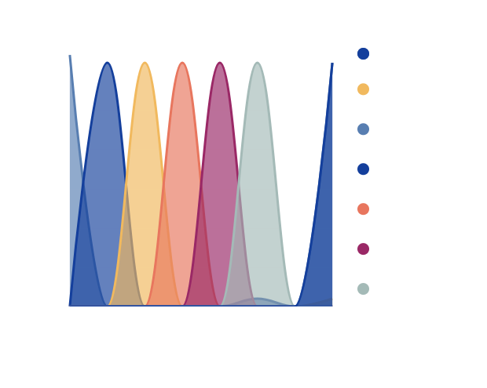
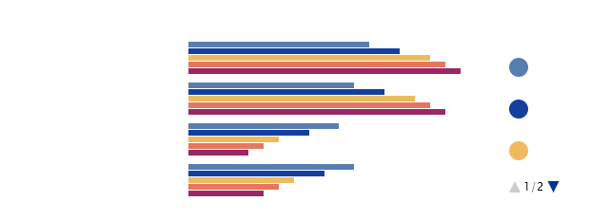

DATA IS A STORY
A simple way to show trends over time. Add more series for comparison.
Confusion Matrix
Model Accuracy and Loss
Classification Report
Notes:
Slide 7: Model Performance Training and Validation Metrics: Show the "Model Accuracy" and "Model Loss" graphs side by side. Key points to highlight: The model achieves high training accuracy (around 90%) by the end of 50 epochs. Validation accuracy plateaus around 82%, indicating some overfitting. Both training and validation loss decrease steadily, with training loss lower than validation loss. Classification Report Analysis: Overall accuracy: 86% (highlight this as a key metric) Category-wise performance: Strong performance: Sport (F1-score: 0.97) Business (F1-score: 0.89) World (F1-score: 0.82) Moderate performance: Politics (F1-score: 0.75) Culture (F1-score: 0.71) Areas for improvement: Environment (low recall: 0.48) Technology (F1-score: 0.00, indicating no correct predictions) Insights: The model performs well on categories with more data (e.g., sport, business). Imbalanced dataset: Some categories (like technology) have very few samples, leading to poor performance. Overfitting: The gap between training and validation accuracy suggests room for improvement in generalization. Next Steps: Address class imbalance (e.g., data augmentation, class weighting) Fine-tune model architecture to reduce overfitting (e.g., more dropout, regularization) Collect more data for underrepresented categories Consider ensemble methods or transfer learning to improve performance on challenging categories

Slide 8


APPROACH - TEAM ROLES
Frank Hanan
La Shawn Sykes
Machine Learning Engineer
Front-end Developer
Project Manager
Notes:
Frank - Machine Learning Engineer: As the Machine Learning Engineer, Frank was the architect behind Neural Newsroom's AI brain. He developed the CNN-LSTM hybrid model that powers our news classification and summarization. Frank built a robust data pipeline, preprocessing text data from The Guardian API, and iteratively refined the model architecture. He implemented key features like tokenization, sequence padding, and category encoding. Frank's expertise in TensorFlow and Keras was crucial in training the model, optimizing its performance, and creating the prediction system. He also developed comprehensive evaluation metrics and visualizations, ensuring the model's accuracy and reliability in classifying diverse news articles.
La Shawn - Front-end Developer and Project Manager: "La Shawn wore two hats in this project, seamlessly blending technical expertise with project leadership. As the Front-end Developer, she crafted an intuitive Gradio interface, bringing the AI's capabilities to users' fingertips. She integrated the ML model with the front-end, enabling real-time news summarization and PDF report generation. As Project Manager, La Shawn orchestrated the entire development process, from initial planning to final delivery. She coordinated team efforts, managed timelines, and ensured smooth communication between all project aspects. Her dual role was pivotal in aligning the technical development with project goals, resulting in a cohesive, user-friendly AI news tool.“
Video URL: https://videos.pexels.com/video-files/3129957/3129957-uhd_3840_2160_25fps.mp4 Video URL: https://videos.pexels.com/video-files/3163534/3163534-uhd_3840_2160_30fps.mp4

Slide 9
CHALLENGES AND SUCCESSES
Handling Noisy Input Data
Achieving High Summarization Accuracy
Ensuring Timely Delivery
Overcome the challenge of processing user-generated news articles with inconsistent formatting, spelling errors, and irrelevant information.
Implemented efficient algorithms and optimized system architecture to provide news summaries to users in near-real-time, meeting their demand for up-to-date information.
Developed advanced natural language processing techniques to generate concise and informative summaries that capture the key points of the original news articles.
Enhancing Multilingual Support
Improving User Experience
Extended the system to handle a wide range of languages, enabling users from diverse linguistic backgrounds to access personalized news summaries.
Iteratively refined the user interface and interaction design to create an intuitive and engaging experience for users, encouraging regular usage of the news summarization service.
Notes:
Slide 9: The development of Neural Newsroom presented us with significant challenges that ultimately led to our greatest successes. One major hurdle was handling the vast and diverse dataset from The Guardian API, which required sophisticated preprocessing and data-cleaning techniques. We grappled with a class imbalance in news categories, particularly with underrepresented topics like technology. This challenge pushed us to refine our model architecture, leading to the development of our innovative CNN-LSTM hybrid, which dramatically improved classification accuracy. Integrating real-time API calls with our ML model for instant summarization was another complex task we successfully overcame. On the front end, creating an intuitive interface that could handle complex queries while delivering a seamless user experience was a significant achievement. Our biggest success lies in the final product – a tool that efficiently summarizes and categorizes news articles with high accuracy, effectively addressing the problem of information overload in digital news consumption. The project not only showcased our technical skills but also our ability to collaborate and innovate under pressure, resulting in a cutting-edge AI application with real-world impact in the news industry.

Slide 10
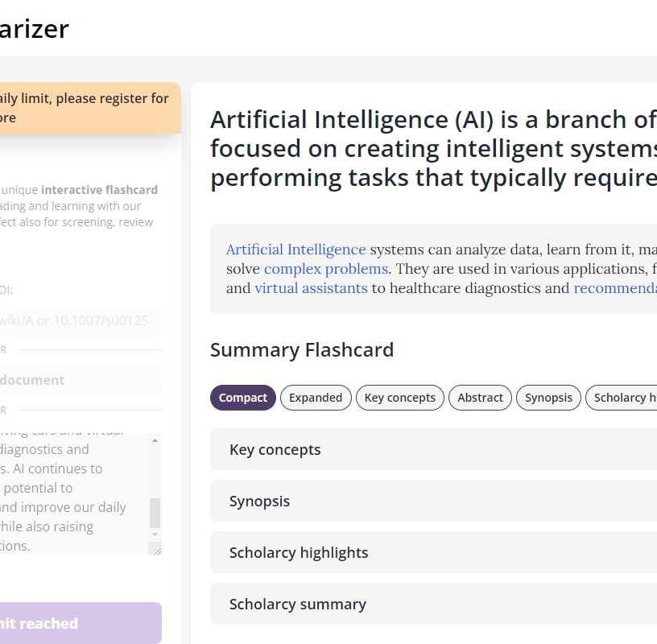
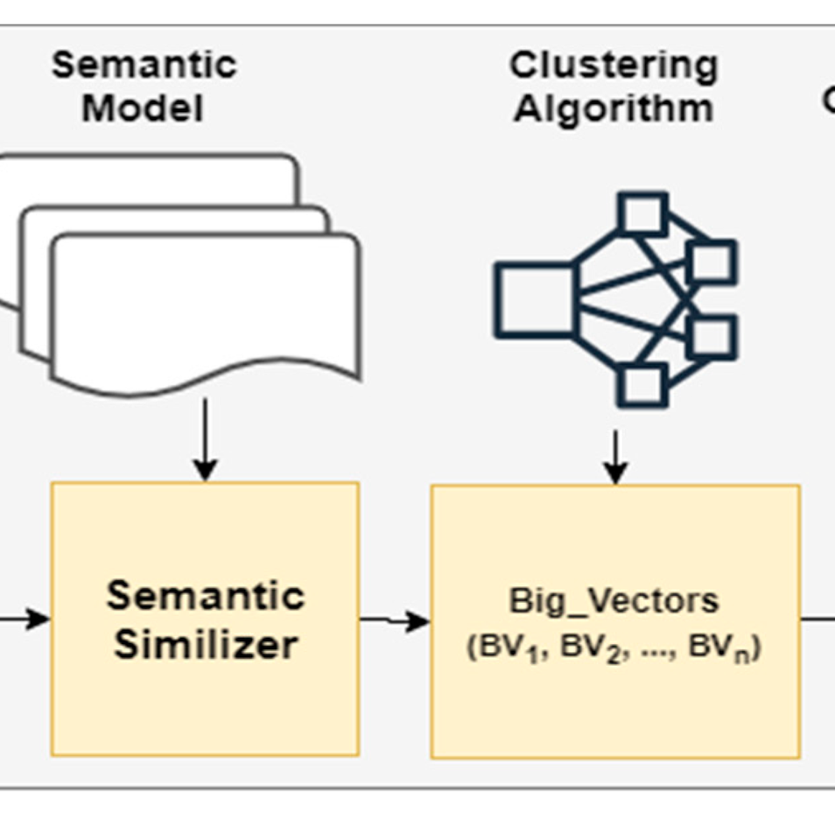
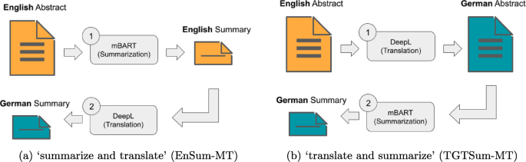
DEMO
News Article Summarization
Customizable Summarization Settings
Multi-Language Support
A screenshot of the neural newsroom interface, showing a news article being summarized by the AI system.
A screenshot demonstrating the various settings and options users can adjust to customize the news article summarization process.
A screenshot showcasing the neural newsroom's ability to summarize news articles in multiple languages, including English, Spanish, and Mandarin Chinese.
Notes:
Slide 10:Opening the Application: "When you first open Neural Newsroom, you're greeted with a clean, intuitive interface. The main screen displays a text input box, dropdown menus for language and sorting options, and a slider for selecting the number of articles to analyze." Inputting a Topic: "Let's start by entering a topic in the text box. For this demo, we'll use 'climate change' as our topic of interest." Selecting Options: "Next, we can choose our preferences. We'll select 'English' from the language dropdown, 'Newest' for sorting, and set the slider to 10 articles." Generating the Summary: "Once we click 'Submit', Neural Newsroom springs into action. You can see a progress bar indicating that it's fetching articles, processing them through our CNN-LSTM model, and generating summaries." Viewing Results: "Within seconds, we get our results. The main text area now displays a comprehensive summary of recent news on climate change. Notice how it's broken down into different categories like 'Environment', 'Politics', and 'Science', showing how our model has classified the articles." Reading Top Snippets: "Below the summary, you'll see a section titled 'Top Articles'. These are brief snippets from the most relevant or impactful articles our system has identified." Checking Sources: "At the bottom, there's a 'Sources' section listing the various news sections these articles came from, ensuring transparency in our summarization process." Downloading the PDF: "If you're satisfied with the summary, you can click the 'Download PDF' button. This generates a neatly formatted PDF report of your news summary, perfect for sharing or offline reading." Trying Different Topics: "Let's try another topic. This time, we'll input 'artificial intelligence'. Notice how quickly the system adapts, providing a new set of summaries and snippets relevant to AI." Adjusting Parameters: "We can also adjust our parameters. Let's change the sorting to 'Oldest' and increase the number of articles to 20. Observe how this affects the depth and breadth of our summary." Conclusion: "And that's Neural Newsroom in action! It offers a quick, efficient way to stay informed on any topic, distilling vast amounts of news into concise, categorized summaries. Whether you're a journalist, researcher, or just someone trying to keep up with the news, Neural Newsroom provides a powerful tool for navigating the information age."

Slide 11




Expand NLP Models
Enhance Summarization Accuracy
NEXT STEPS
Integrate Multi-Modal Processing
Improve User Interface Design
Notes:
Slide 11:Moving forward, we've identified several key areas for enhancement and expansion of Neural Newsroom. Our primary recommendation is to broaden our data sources beyond The Guardian, incorporating diverse news outlets to provide a more comprehensive and balanced news summary. We aim to implement multi-language support, enabling users to access news from global sources. To improve accuracy, we plan to explore advanced NLP techniques like transformer models and transfer learning. User personalization is another critical area; we envision developing a feature that learns from user interactions to tailor summaries to individual interests. On the technical side, we recommend optimizing our model for faster processing and exploring cloud-based solutions for scalability. We also see potential in developing a mobile application to increase accessibility. Lastly, we propose conducting extensive user testing to gather feedback and refine the user experience. These next steps will not only enhance Neural Newsroom's capabilities but also position it as a cutting-edge tool in the evolving landscape of AI-driven news consumption.

Slide 12

GITHUB
Project Data Repository

